Slide 1
STUDENT NAME:SAI PRASATH S
REGISTER NO AND NMID:212400967-F7B5B3E30AA8AF599E449F8D446CCDD9
DEPARTMENT:BCA
COLLEGE:PRINCE SHRI VENKATESHWARA ARTS AND SCIENCE COLLEGE

Slide 2
Responsive Design
DIGITAL PORTFOLIO
PROJECT TITLE

Slide 3
AGENDA
1.Problem Satement
2.Project Overview
3.End Users
4.Tools and Technologies
5.Portfolio Design And Layout
6.Features And Functionality
7.Results and Screenshots
8.Conclusion
9.Github Link

Slide 4
PROBLEM STATEMENT
1. Limited Online Presence
Many developers lack a personal portfolio to showcase skills and projects effectively.
2. Static Resumes are Outdated
Traditional resumes cannot demonstrate interactivity, creativity, or coding ability.
3. Difficulty Showcasing Skills
Recruiters and peers need a simple, structured way to view technical expertise.
4. Poor User Engagement in Plain Websites
Simple text-based pages don't capture attention or provide a modern feel.
5. Navigation Challenges
Without proper features, scrolling th inconvenient. long

Slide 5
PROJECT OVERVIEW
1. Personal Portfolio Website
A web-based platform to showcase my skills, experience, and contact details.
2. Modern UI Design
Implemented a vibrant gradient background with animations for a unique look.
3. Responsive Layout
Optimized for desktops, tablets, and mobile devices using flexible CSS grid and section design.
4. Interactive Features
Fade-in animations when scrolling.
Scroll-to-top button for better navigation.

Slide 6

WHO ARE THE END USERS?
1. Recruiters & Hiring Managers
To evaluate my technical skills (HTML, CSS, JS, Python, C++).
To view my projects and coding ability.
To check professionalism and creativity in design.
2. Potential Employers / Companies
To get a quick overview of my qualifications (BCA background).
To assess if I fit the company's needs for front-end development roles.
3. Networking Connections (Linkedin, GitHub Visitors)
To connect with me for collaboration.
To see my open-source contributions and repositories.

Slide 7
TOOLS AND TECHNIQUES
1.HTML CODE
2.CSS

Slide 8
PORTFOLIO DESIGN AND LAYOUT
Layout Structure
Header:
Name & tagline (profession + skills).
Center aligned with neon text effects.
Sections (Stacked vertically):
a. About Me introduction. ← Personal
b. Skills abilities. ← List of technical
c. Contact GitHub. ← Email, Linkedin,
Footer:

Slide 9
FEATURES AND FUNCTIONALITY
1. Responsive Layout
Sections (About, Skills, Contact) are centered with max-width for readability.
Grid layout for projects (auto-fit adapts to screen size). ←
Mobile-friendly with viewport meta tag.
2. Vaporwave Gradient Background
Background animation using linear-gradient.
Keyframes (@keyframes vaporwaveFlow) create a smooth color flow effect.
Gives a modern neon aesthetic.

Slide 10
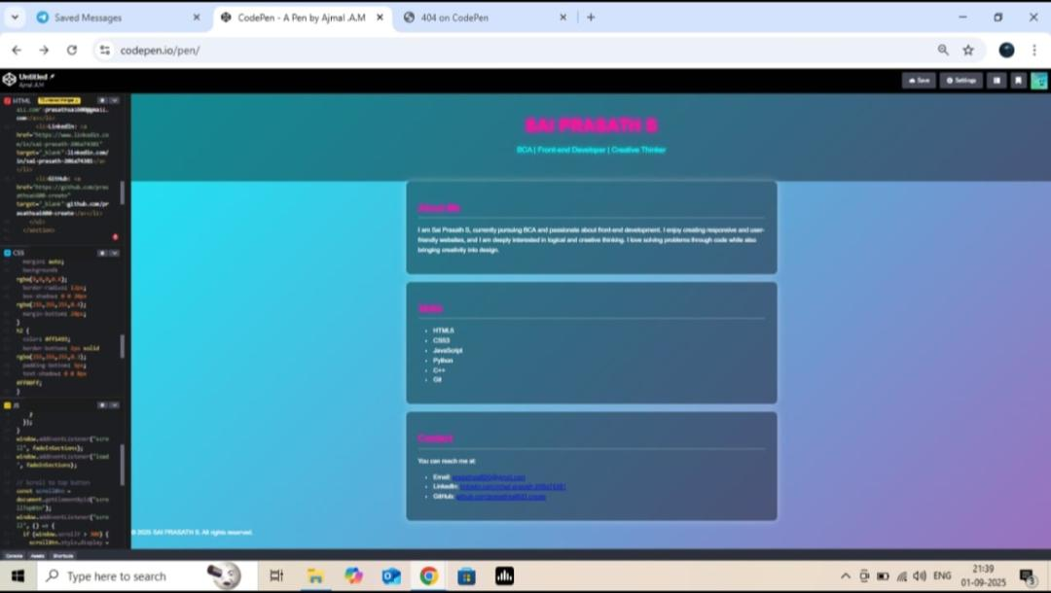
RESULTS AND SCREENSHOT

Slide 11
Conclusions
In summary, adopting responsive design principles in presentations is essential for catering to todays diverse audience. This approach not only improves user experience but also ultimately drives engagement and effectiveness. By applying the right tools, best practices, and learning from successful examples, presentations can become more impactful and versatile.

